Slide 1

SALARY PREDICTION USING ML
PROJECT GUDIE
J.HAIR KRISHNA
- M.CHANDRASHEKAR
-228W1F0037

Slide 2
ABSTRACT
In today’s world, salary is the primary source of motivation for many regular employees, which makes salary prediction very important for both employers and employees. It helps employers and employees to make estimations of the expected salary. Fortunately, technological advancements like Data Science and Machine Learning (ML) have made salary prediction more realistic. In this paper, we exploit the benefits of data science to collect a 20,000+ dataset of salaries in the USA. We then apply three supervised ML techniques to the obtained datasets to produce salary prediction. The learning models are linear regression, random forest, and XG BOOST The output of the three models is analyzed and compared to show the following; neural network outperforms the other ML models for better accuracy with accuracy level 97.2%, and linear regression has the fastest time of 0.363s for training the model.

Slide 3
EXISTING SYSTEM
In the existing system we can store the data manually or office computers
In the existing models have low latency. Existing systems do not have a specific user interface
The decision tree accuracy rate 79%
The linear regression accuracy rate at 80%

Slide 4
PROPOSED SYSTEM
To enhance prediction method to predict the salary using machine learning technology.
We achieved 95.6% prediction accuracy using XG BOOST algorithm with lowest false positive rate

Slide 5
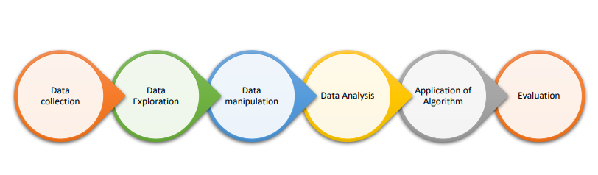
PROPOSED APPORACH
Data Collection: Collecting raw data from billions of datasets available.
• Data Exploration: Exploring the data & the features related and being familiar with thedata-types.
• Data Manipulation: Includes Cleaning of data, treating missing, repetitive values that are present.
• Data Analysis: Analysing the data to increase efficiency while applying the best Algorithm& feature selection according to our preferences.
• Application of Algorithm: Applying the algorithm to the model.
• Evaluation: Using evaluation metrices to calculate the least error and following the above to make further changes

Slide 6

WHY MACHINE LEARNING?

Slide 7
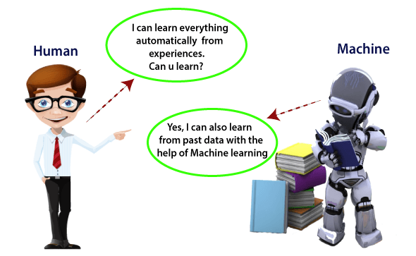
A rapidly developing field of technology, machine learning allows computers to automatically learn from previous data. For building mathematical models and making predictions based on historical data or information, machine learning employs a variety of algorithms. It is currently being used for a variety of tasks, including speech recognition, email filtering, auto-tagging on Facebook, a recommender system, and image recognition

Slide 8
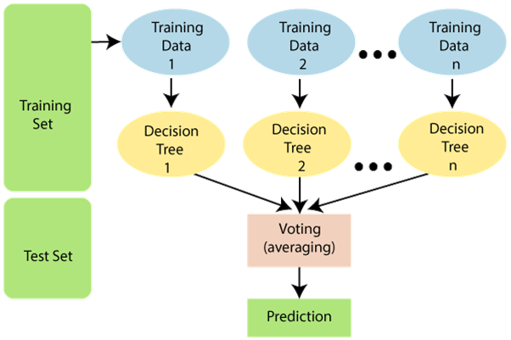
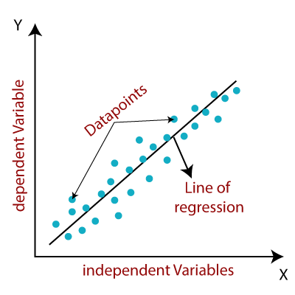
RANDOM FOREST
LINEAR REGRESSION
Random Forest is a popular machine learning algorithm that belongs to the supervised learning technique. It can be used for both Classification and Regression problems in ML. It is based on the concept of ensemble learning, which is a process of combining multiple classifiers to solve a complex problem and to improve the performance of the model.
Linear regression is one of the easiest and algorithms. It is a statistical method that is used for predictive analysis. Linear regression makes predictions for continuous/real or numeric variables such as sales, salary, age, product price, etc.ost popular Machine Learning.
Linear regression algorithm shows a linear relationship between a dependent (y) and one or more independent (y) variables, hence called as linear regression. Since linear regression shows the linear relationship, which means it finds how the value of the dependent variable is changing according to the value of the independent variable.

Slide 9
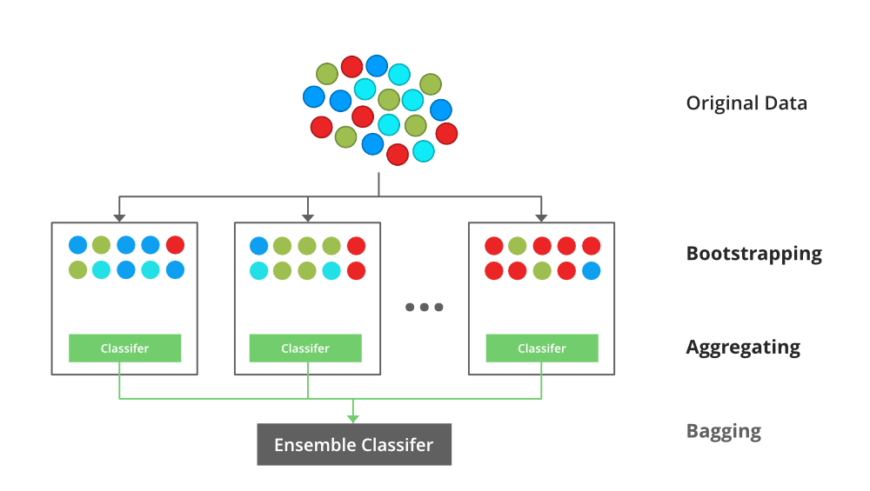
XG BOOST
XGBoost is a robust machine-learning algorithm that can help you understand your data and make better decisions.
XGBoost is an implementation of gradient-boosting decision trees. It has been used by data scientists and researchers worldwide to optimize their machine-learning models.
XGBoost is designed for speed, ease of use, and performance on large datasets. It does not require optimization of the parameters or tuning, which means that it can be used immediately after installation without any further configuration.

Slide 10
SYSTEM REQUIREMENTS
SOFTWARE REQUIREMENTS
HARDWARE REQUIREMNETS
Jupyter Notebook
Python
PyCharm
Google colb
GitHub
Computer/Laptop
Processer: i5 or more
8GB RAM
Operating System
Internet

Slide 11
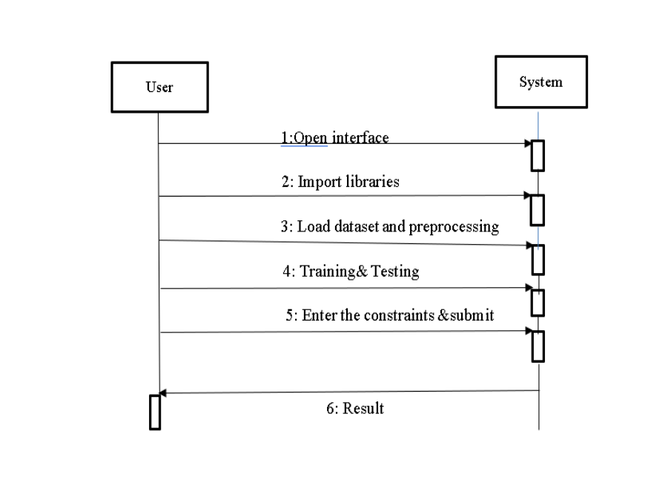
UML- SEQUENCE DIAGRAM

Slide 12
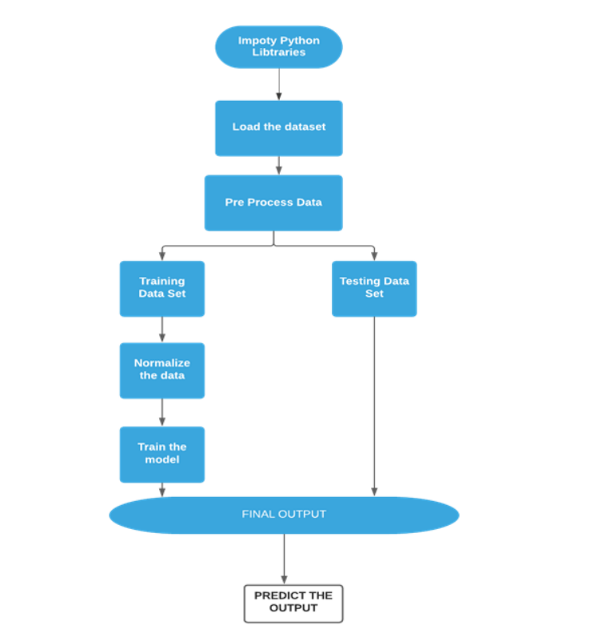
DATA FLOW CHART

Slide 13
FEATURE SELECTION
FEATURE SELECTION IS BASED ON THE ONE OF THE SOFTWARE COMPANY.
ROLE IN THE SOFTWARE COMPANY AND YEARS OF EXPERIENCE IN THAT ROLE AND ALSO BASED ON EDUCATION TYPE
BASED ON AGE,GENDER,ROLE ,EDUCTION TYPE, EXPERIENCE WE PREDICTION THE SALARY

Slide 14
DATA SET
NAME | DESCRIPTION
AGE | AGE OF THE EMPLOYEE
GENDER | MALE OR FEMALE
EDUCATION | BACHELORS OR MASTERS OR PHD
JOB TITLE | ROLES IN SOFTWARE COMPANY
YEARS OF EXPERIENCE | EXPERIENCE ON PARTICULAR ROLE
SALARY | BASED ON ROLE AND EXPERIENCE

Slide 15
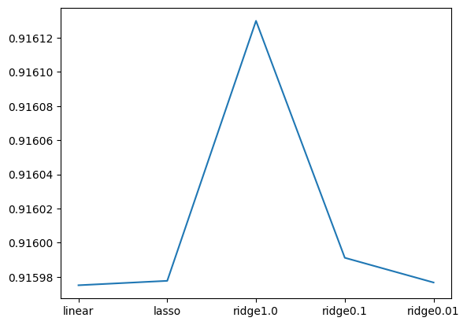
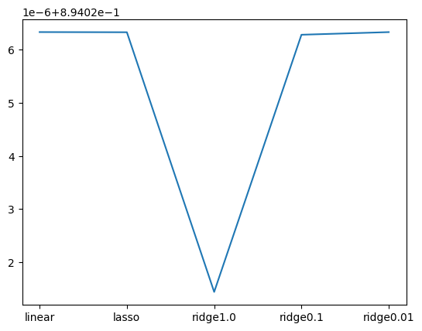
ACCURACY FOR LINEAR REGRESSION
The method we've introduced in our approach consistently demonstrates an impressive average accuracy rate of 93%
Average train accuracy is 91%
Average test accuracy is 89%

Slide 16
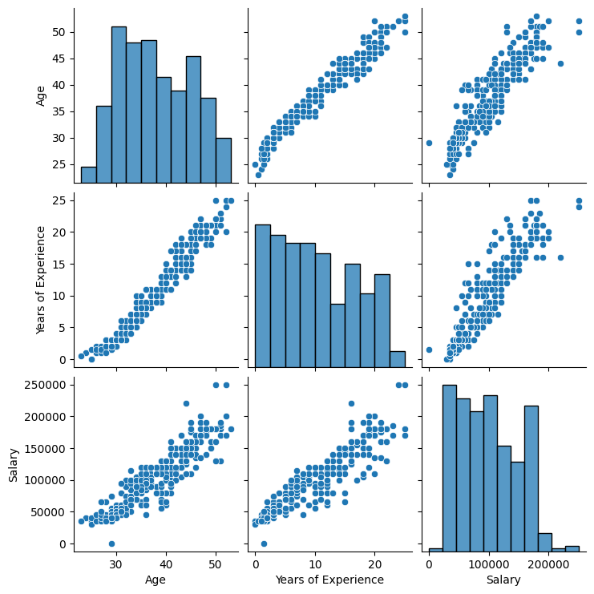
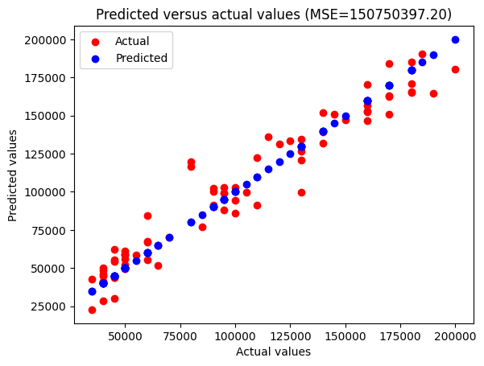
ACCURACY FOR LINEAR REGRESSION

Slide 17
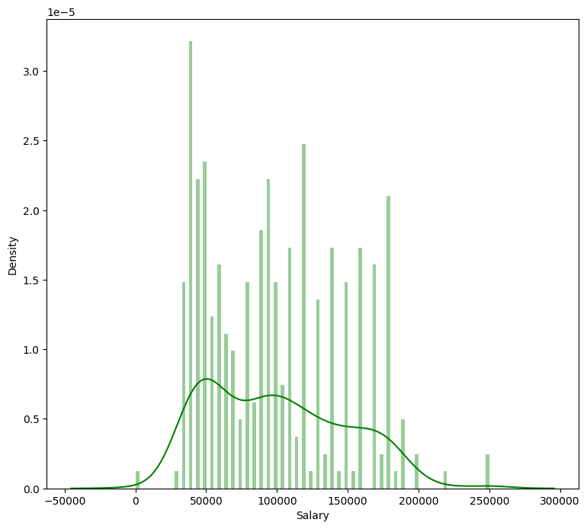
ACCURACY FOR DECISION TREE
The method we've introduced in our approach consistently demonstrates an impressive average accuracy rate of 90%.
Average train accuracy 88%
Average test accuracy is 87%

Slide 18
RANDOM FOREST Vs XG BOOST
RANDOM FOREST
XG BOOST
The method we've introduced in our approach consistently demonstrates an impressive average accuracy rate of 94%.
Train accuracy RF : 0.9484001379382995
Test accuracy RF: 0.8936890185482345
The method we've introduced in our approach consistently demonstrates an impressive average accuracy rate of 95%.
Train accuracy XG: 0.9585752633021621
Test accuracy XG: 0.881430580331474

Slide 19
CONCLUSION
In this paper suggests that machine learning, especially XG BOOST, can be a valuable tool for salary prediction. It provides accurate predictions, which can benefit both employers and employees. However, it's important to note that the accuracy rates provided in the paper may vary depending on the dataset, feature selection, and other factors, and the model's performance should be validated on different datasets for robustness.
Compared the performance of these models, particularly in terms of accuracy and speed:
Linear Regression: Achieved an average accuracy rate of 93%, with a training accuracy of 91% and a test accuracy of 89%. It had the fastest training time of 0.363s.
Decision Tree: Achieved an average accuracy rate of 90%, with a training accuracy of 88% and a test accuracy of 87%.
Random Forest: Achieved an average accuracy rate of 94%, with a training accuracy of 94.8% and a test accuracy of 89.4%.
XG BOOST: Achieved the highest average accuracy rate of 95%, with a training accuracy of 95.9% and a test accuracy of 88.1%. It also had the lowest false positive rate, making it a strong performer.
Based on the results, it can be concluded that XG BOOST outperforms the other machine learning models in terms of accuracy, with an impressive accuracy level of 95.6%. It also had the lowest false positive rate, which is important in salary prediction. Random Forest also performed well, with a high average accuracy rate of 94%. Linear Regression and Decision Tree, while still performing reasonably well, had slightly lower accuracy levels.

Slide 20
FUTURE SCOPE
The future scope for the work described in paper on salary prediction using machine learning techniques is quite promising. Here are some potential directions for future research and applications:
Continuously working on improving the accuracy and performance of machine learning models for salary prediction is a valuable endeavor. This could involve exploring more advanced ML techniques, hyperparameter tuning, or collecting larger and more diverse datasets.
The future scope for salary prediction using machine learning is broad and dynamic. It involves a combination of improving technical aspects, addressing ethical and fairness concerns, and providing practical tools and services for employees and employers. It's a field with significant potential for positive impact in the job market and compensation negotiations.

Slide 21

ANY QUESTIONS?

Slide 22
Thank you
-M.CHANDRA SHEKAR
-228W1F0037

